Slide 1



Building Text-Based Applications with the ChatGPT API & LangChain
How to build LLM apps
Lucas Soares
21-08-2023

Slide 2
Introduction to prompt engineering and the ChatGPT API
1
Prompt basics
3
Prompt engineering guide
Best practices for writing effective prompts
2
Introduction to the ChatGPT API
4

Slide 3
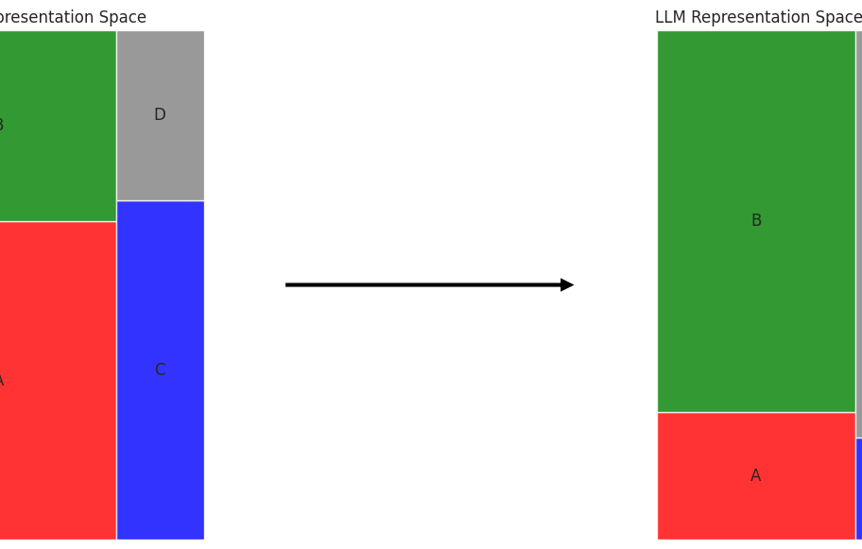
1
Prompt Basics
A prompt is a piece of text that conveys to the LLM the user’s intention.
Question → Instruction → Behavior

Slide 4
1
Components of a prompt
Task, input, context, style
Context information: background info on what you are requesting, the data you are providing etc
Task description: where you describe what you want
Input data: data the model has not seem to illustrate what you need
Prompt style: its how you ask the thing to the model

Slide 5
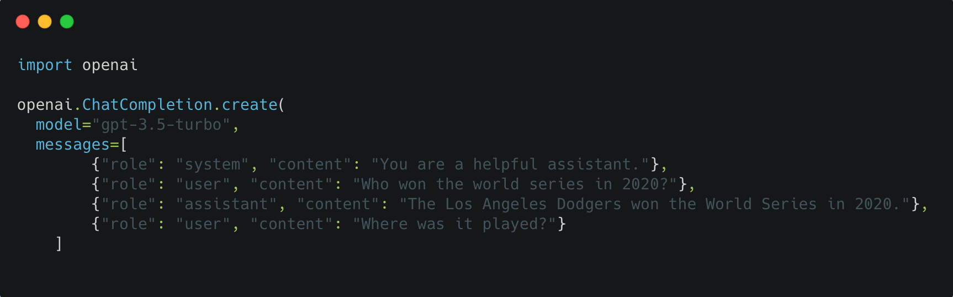
2
Introduction to the ChatGPT API
Where does ChatGPT fit in this chaotic LLM universe?
2
The ChatGPT API allows us to use OpenAI's chat models to generate dynamic, contextually-aware responses.
Specify: model, messages.

Slide 6
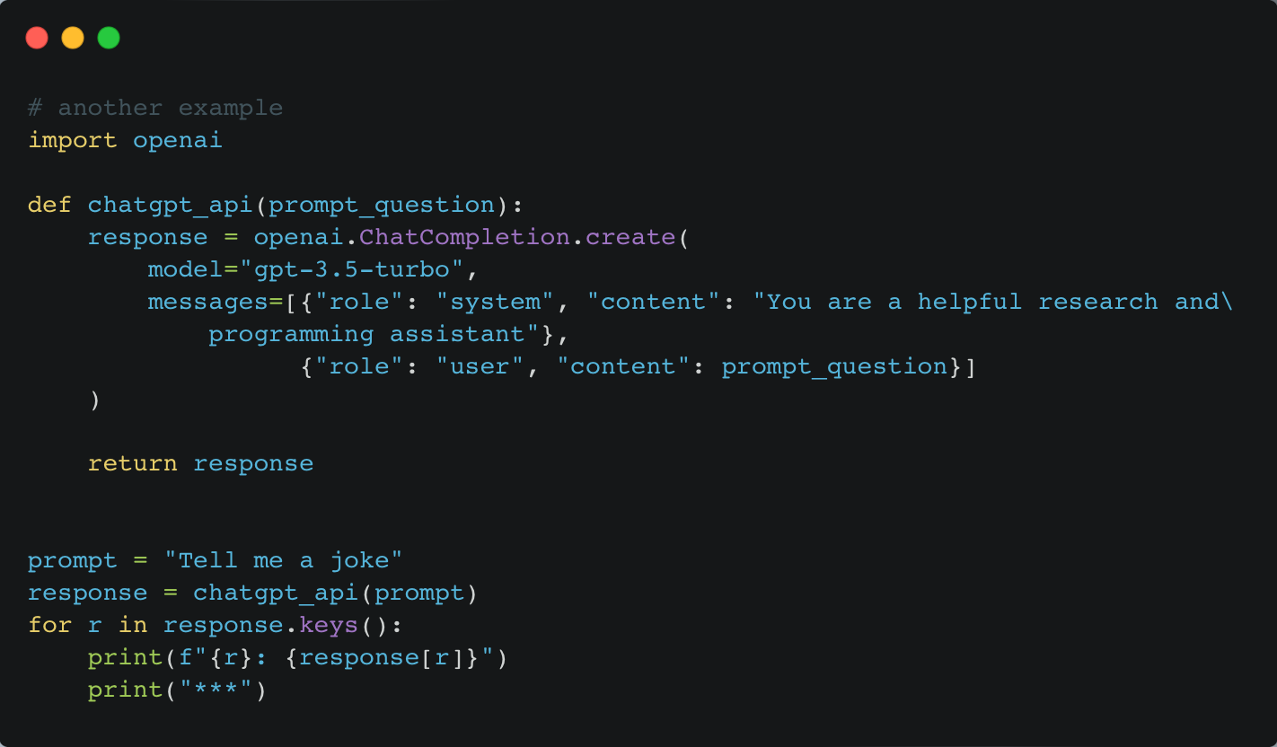
2
Introduction to the ChatGPT API
Where does ChatGPT fit in this chaotic LLM universe?
2
Firstly we import the OpenAI module.
We call the .create() method to call the API.
We give the model and messages parameters.

Slide 7
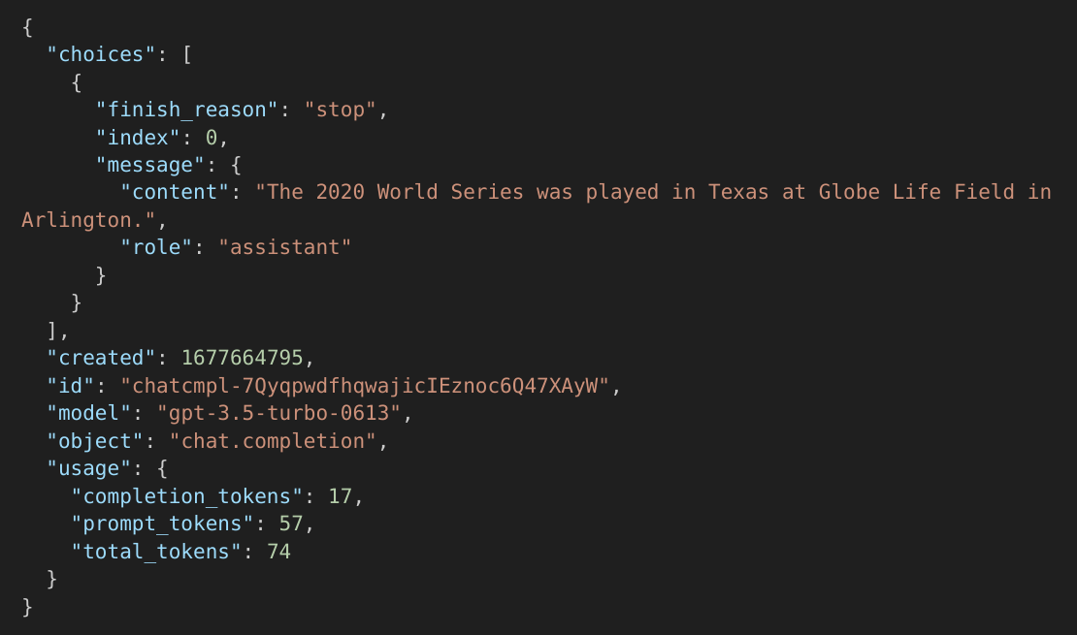
2
Introduction to the ChatGPT API
A breakdown of the response
2

Slide 8
Prompt Engineering Guide
3
What is prompt engineering?
Prompt engineering: discipline concerned with establishing the rules for obtaining the most deterministic outputs possible from a LLM by employing engineering techniques and protocols to ensure reproducibility and consistency.
In a simplified way, prompt engineering is the means by which LLMs can be programmed through prompting.
Prompt engineering is the process of creating a prompting function fprompt(x) that results in the most effective performance on the downstream task.
The basic goal of prompt engineering is designing appropriate inputs for prompting methods.

Slide 9
Prompt Engineering Guide
3
Prompt Composition: breaking down a task into a set of sub-tasks then solving these with sub-prompts to form a composite prompt.
Prompt Scoring: scoring prompt candidates to solve a task by leveraging strategies like using a unidirectional LLM (Davison et al. 2019).

Slide 10
Prompt Engineering Techniques
3
A simplified guide of prompting techniques
Zero-shot Prompting
Self-Consistency
Few-shot Prompting
Generate Knowledge
Chain-of-Thought
Tree of thoughts (ToT)

Slide 11
Zero-shot Prompting
3
2
Zero-shot prompting is when you solve the task without showing any examples of what a solution might look like
Example - Classify the sentiment in this sentence as negative or positive:
Text: I will go to a vacation.
One can use this as the first try at a model to see what kind of tasks LLM can already solve out of the box

Slide 12
Few-shot Prompting
3
Provide information in the form of examples to the LLM
Few-shot Prompting: technique where you show a few examples of what a solution might look like.
Example - A "whatpu" is a small, furry animal native to Tanzania.
An example of a sentence that uses the word whatpu is: We were traveling in Africa and we saw these very cute whatpus.
To do a "farduddle" means to jump up and down really fast. An example of a sentence that uses the word farduddle is:
The goal is to enable what is called 'in-context learning' where the model improves by learning contextual information about the task at hand.
We do that by giving demonstrations that serve as conditioning for subsequent examples for which we would like the model to generate a response.

Slide 13
Chain-of-Thought
3
Induce step-by-step reasoning and planning
Chain-of-thought (CoT) enables complex reasoning capabilities through intermediate reasoning steps (Wei et al. 2022).
Example - Q: I have one sister and one brother. I am 20 years of age. My sister is 5 years older and my brother 2 years younger than my sister.​ How old is my brother?​
A: If I am 20 years of age and my sister is 5 years older, my sister is 20+5=25 years old. If my brother is 2 years younger than my sister, my brother is 25-2=23 years old. The answer is 23 years old.​
​
Q: I have 2 friends, Jack and Sally. Jack is 2 years older than Sally. Sally is 5 years younger than me. I am 17 years old. How old is Jack?​

Slide 14
Self-Consistency
3
Induce step-by-step reasoning and planning
First, use few shot prompting and chain of thoughts to sample reasoning paths.
Then, use generations to select the most consistent answer (Wang et al. 2023​).

Slide 15
Self-Consistency
3
Induce step-by-step reasoning and planning
Input: Greece is larger than Mexico.​
Knowledge: Greece is approximately 131,957 sq km, while Mexico is approximately 1,964,375 sq km, making Mexico 1,389% larger than Greece.​
Input: Glasses always fog up.​
Knowledge: Condensation occurs on eyeglass lenses when water vapor from your sweat, breath, and ambient humidity lands on a cold surface, cools, and then changes into tiny drops of liquid, forming a film that you see as fog. Your lenses will be relatively cool compared to your breath, especially when the outside air is cold.​
Input: A fish is capable of thinking.​
Knowledge: Fish are more intelligent than they appear. In many areas, such as memory, their cognitive powers match or exceed those of ’higher’ vertebrates including non-human primates. Fish’s long-term memories help them keep track of complex social relationships.​
Input: A common effect of smoking lots of cigarettes in one’s lifetime is a higher than normal chance of getting lung cancer.​
Knowledge: Those who consistently averaged less than one cigarette per day over their lifetime had nine times the risk of dying from lung cancer than never smokers. Among people who smoked between one and 10 cigarettes per day, the risk of dying from lung cancer was nearly 12 times higher than that of never smokers.​
Input: A rock is the same size as a pebble.​
Knowledge: A pebble is a clast of rock with a particle size of 4 to 64 millimetres based on the Udden-Wentworth scale of sedimentology. Pebbles are generally considered larger than granules (2 to 4 millimetres diameter) and smaller than cobbles (64 to 256 millimetres diameter).​
Input: Part of golf is trying to get a higher point total than others.​

Slide 16
Generate Knowledge
3
Induce step-by-step reasoning and planning
Example - Question: Part of golf is trying to get a higher point total than others. Yes or No?​
Knowledge: The objective of golf is to play a set of holes in the least number of strokes. A round of golf typically consists of 18 holes. Each hole is played once in the round on a standard golf course. Each stroke is counted as one point, and the total number of strokes is used to determine the winner of the game.​ Explain and Answer:
This technique is about inserting knowledge into the prompt in order to yield better performance.
Use the model to generate knowledge about a field, and then use that generated knowledge to improve its performance on a downstream task.

Slide 17
Tree of thoughts (ToT)
3
Generalizing over Chain of Thought Prompting

Slide 18
There are many more prompt engineering techniques that grow in complexity, such as:
- Retrieval Augmented Generation (RAG)
- Automatic Prompt Engineer
- Active Prompt
- Directional Stimulus Prompting
- React Prompting
- Mulitmodal CoT
- Graph Prompting

Slide 19
A Framework for Building Good Prompts
4

Slide 20
Exercise / Lab
Getting started with prompt engineering using the ChatGPT API
Extracting dates from unstructured data
Prompt engineering for text summarization and question answering

